Slide 1
Tracing Gesture and Extracting Gait Features to Recognize Parkinson’s Disease Using Machine Learning Techniques
ANUBHA PARASHAR
Pursuing PhD
SCHOOL OF COMPUTING AND INFORMATION TECHNOLOGY
Computer Science and Engineering
MANIPAL UNIVERSITY, JAIPUR, INDIA

Slide 2
Outline
GAIT/ Human GAIT
AIM
Proposed work and Methodology
Data Collection & Demos
Conclusion
Result analysis
Classification using KNN and Back Propagation
Problem Statement
Proposed Solution

Slide 3
What is GAIT?
Gait
Gait refers to the manner in which a person walks, and is one of the few biometric traits that can be used to recognize people/disease at a distance.
Therefore, this trait is very appropriate in detecting disease and gait recognition system.

Slide 4
Human gait
Human gait analysis refers to the study of human locomotion.
Applications are in a large variety of domains, including entertainment, healthcare, security like surveillance scenario and pedestrian navigation.
The act of walking involves the coordination of different human body parts, such as the skeleton, the muscle and the neural systems.
Various factors can affect the complex interaction between the body parts, for example any pathological nature will require a distinction between ― normal gait and pathological gait.
Normal gait refers to the general human walking parameters without differentiating the age, sex or physical parameters.
Pathological gait refers to an abnormal gait, for example affected by pathologies such as muscle weakness or skeleton deformities or due to anxiety.

Slide 5
Problem Statement
By using gait data doctors can differentiate between a normal walking person and a person impaired with Parkinson’s disease.
When the treatment and medicines are given to the patient then analyzing the gait features can be one of the important activity to see whether the patient is recovering or not.
Parkinson’s is a very serious and inoperable disease. It is remediless.
A person suffering from Parkinson’s cannot be fully cured. But the agony can be minimalized or the growth rate of the disease can be slowed down if found in the premature stages.

Slide 6
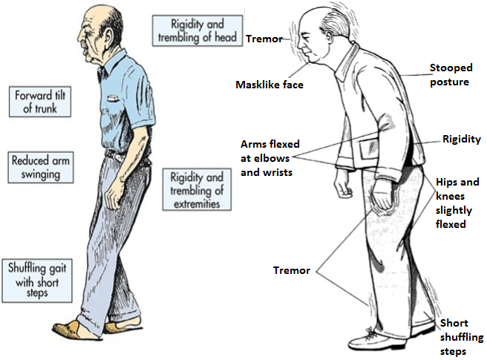
Problem Statement

Slide 7
Proposed Solution
Identifying normal or pathological human gait. Therefore a robust method for detecting and capturing the gait of each individual person has to be found.
Human gait is supposed as unique biometric identification like thumb print.
So in GAIT analysis to examine the human walking moment we collect and analyze the data.
This can be done with the aid of biometric techniques. We can collect the human locomotion data and check if there is any sign of disorder.

Slide 8
Proposed Solution
We can find out whether the person is walking normally or not.
If any disruption is found in the gait of the person we will get to know that there may be chances of disorder and then we can further diagnose the person based on the collected data to detect the disease.
Medication can also be started to fix the disorder.

Slide 9

AIM
The aim of the paper is to evaluate and implement robust and accurate method to identify whether it’s a normal gait or pathological gait for healthcare and detect Parkinson disease at early stage.

Slide 10
Methodology
Thursday, September 6, 2018

Slide 12
Methodology
Firstly we collect the GAIT data then features are extracted and we classify the GAIT dataset.
Training and testing of system is done.
After the Classification is done result is shown as normal or pathological GAIT.
Then 10 fold cross-validation test is also conducted to validate the statistical significance of the results.

Slide 13
Data Collection
The data set is collected from following link
http://www.physionet.org/pn3/gaitpdb/.
This is the gait dataset of 166 people.
Out of which 93 patients are suffering from Idiopathic Parkinson’s disease (63% men, average age is 66.3 years).
The rest of the 73 people are healthy and average age of healthy people is found to be 66.3 years out of which 55% are men.
8 sensors have been put to practical use under each foot of the individual.
The output recorded is based on the readings of 16 sensors (i.e. 8 of each foot) and is recorded as 100 samples per second. The final work is taken by 2 signals that mirror the tally of 8 sensors of each foot.

Slide 14
Feature Selection and Extraction
It is quite difficult to work with collected data to classify whether a person is having a normal gait or having Parkinson’s disease.
So we extract required features from the gathered data and then classification is done on the extracted features.
Various classification algorithms will be executed with the goal to classify whether a person is having a normal gait or having Parkinson’s disease.
The performance of classification algorithms will be analyzed.

Slide 15
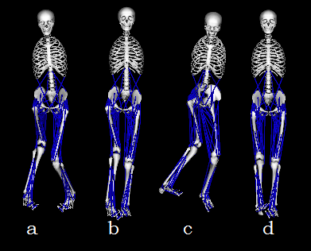
Simulation of dataset in openSim

Slide 16
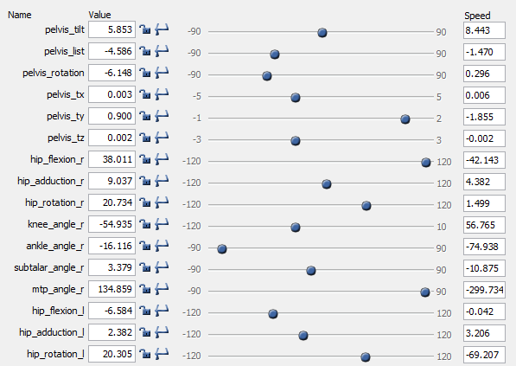
Values of abnormal dataset

Slide 17
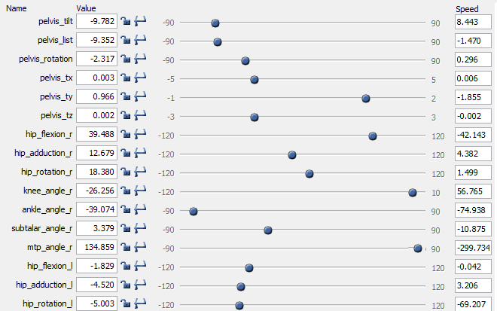
Values of abnormal dataset

Slide 18
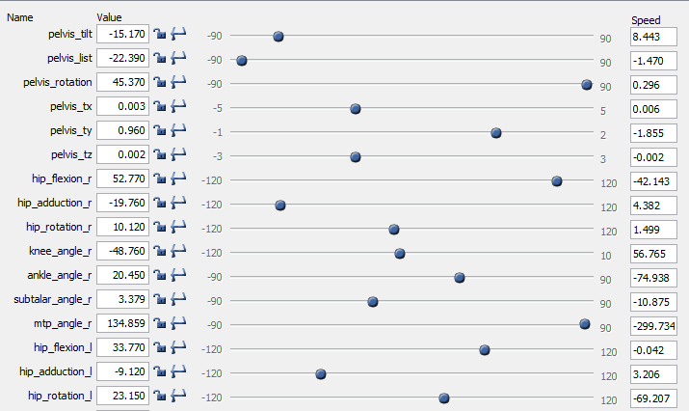
Values of abnormal dataset

Slide 19
Values of normal dataset

Slide 20
Feature Selection
Feature Category | Feature Name
F1 | Pelvis_tilt
F2 | Pelvis_list
F3 | Pelvis_rotation
F4 | Pelvis_tx
F5 | Pelvis_ty
F6 | Pelvis_tz
F7 | hip_flexion_r
F8 | hip_adduction_r
F9 | hip_rotation_r
F10 | knee_angle_r
F11 | ankle_angle_r
F12 | ankle_angle_l
F13 | knee_angle_l
F14 | hip_flexion_l
F15 | hip_adduction_l
F16 | hip_rotation_l

Slide 21
Classification
K-Means, KNN, ANN

Slide 22
CLASSIFICATION
Classification is the problem of identifying to which set of categories (sub-populations) a new observation belongs, on the basis of a training set of data containing observations (or instances) whose category membership is known.

Slide 23
CLASSIFICATION TECHNIQUES USED
CLASSIFICATION of GAIT data is done using following techniques:
K-Means
KNN
ANN

Slide 24
K-Means
ACCURACY | Test accuracy (%)
 | 74.68 %

Slide 25
KNN
KNN can be used for both classification and regression predictive problems [1].
It is very much sensitive for outlier and noise.
It is applicable only for numerical data.

Slide 26
KNN Result
ACCURACY | KNN(k=1,2,3,4,5)
 | 100,98,95,92,88

Slide 27
ANN Result
ACCURACY | ANN
 | 98.02

Slide 28
Accuracy percentage of different GAIT data classification
Results
K-Means | KNN(k=1,2,3,4,5) | ANN
74.68 | 100,98,95,92,88 | 98.02

Slide 29
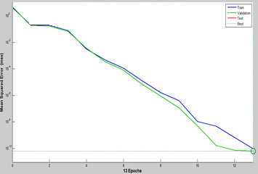
Comparison of success rate by different algorithms using 10–fold cross validation
After this, 10-fold cross validation was used to check overall accuracy of the system.
FACTORS | ANN | KNN
Correlation coefficient | 0.9955 | 1.232
Mean absolute error | 8.2394 | 9.4324
Root mean squared error | 117.3938 | 132.3233
Relative absolute error | 0.741 % | 0.841%
Root relative squared error | 9.4381 % | 10.4322%
Total Number of Instances | 204 | 204
Classifier | Rate of Success (%)
KNN | 87.32 %
Back Propagation | 98.02 %

Slide 30
ROC CURVE

Slide 31
Conclusion
The main concern of research has been identification of abnormality, disorder and upcoming disease at primary stage.
The experimental result demonstrated that while maintaining a high recognition accuracy rate, the proposed method could accurately recognize various activities in both input and output scenarios.
The GAITs are classified into two different classes- Normal and Abnormal gait, effectively by the novel classification.
ANN, K-mean and KNN algorithms were used to compare the result and it has been shown that our classification surpasses the subsisting classifiers.

Slide 32
Cntribution to Research
We have taken the accuracy to 98.02% which is 1.02% more times than Nielsen, Michael (2016) "International Conference on Computational Intelligence and Natural Computing“ got 97% accurate results but our classification has better accuracy than this.

Slide 33
Questions?

Slide 34
Thank you
Have a great day ahead

